Slide 1



Workshop Day 1: software familiarization, forecast weather and oceanographic conditions, software feasibility.
Exercise
Chalmers University of Technology
April 5th, 2022

Slide 2
Copernicus is an EU programme aimed at developing European information services based on satellite Earth Observation and in situ (non space) data.
Copernicus is implemented by the European Commission (EC) with the support from the European Space Agency (ESA) for the Space component and the European Environment Agency (EEA) for the in situ component.
The objective of Copernicus is to monitor and forecast the state of the environment on land, sea and in the atmosphere, in order to support climate change mitigation and adaptation strategies, the efficient management of emergency situations and the improvement of the security of every citizen. Information provided by Copernicus improves people's safety, e.g. by providing information on natural disasters such as forest fires or floods, and thus help to prevent the loss of lives and property, and damages to the environment.
Copernicus is a user driven programme and the information services provided are available to its Users, mostly public authorities, on a full, open and free-of-charge basis.
SIMROUTE EXECUTION
SIMROUTE is a program composed by several scripts and Matlab functions which, when executed sequentially, allow for the definition of a computational mesh according to the selected longitudes and latitudes. Furthermore, it also allows for the definition of start and end nodes in order to carry out the route optimization between these two nodes.
The execution sequence is the following:
a. start.m
b. make_mesh.m
c. make_waves_Copernicus.m
d. find_ports
d. simroute_Opt.m
e. simroute_Dmin.m
f. plot_routes_and _waves
g. make_emissions_DELTA_2021

Slide 3
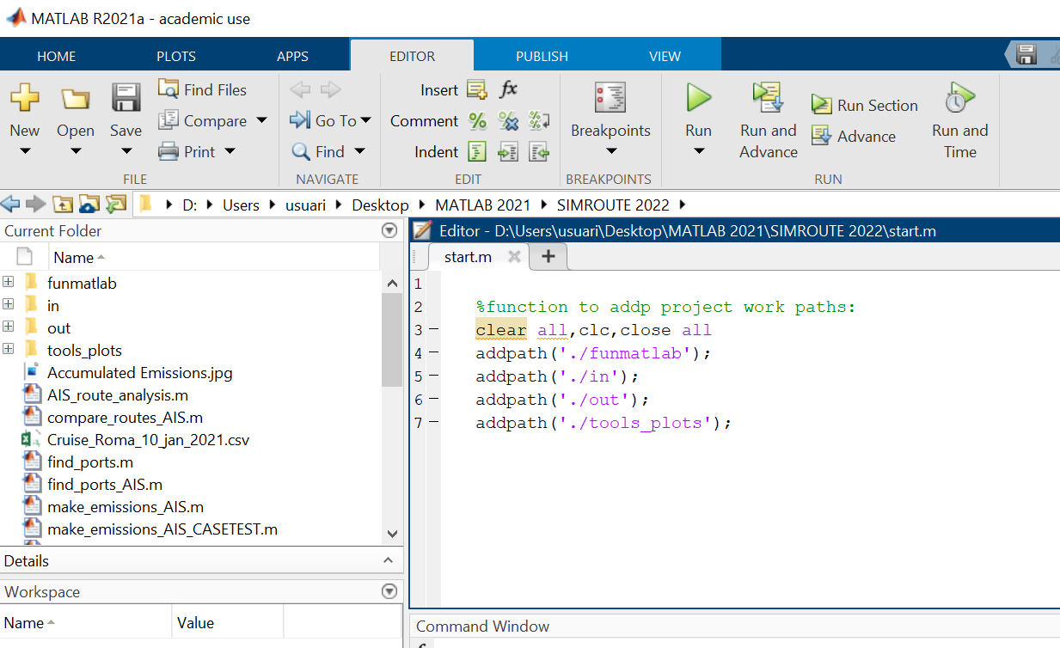
Copernicus is an EU programme aimed at developing European information services based on satellite Earth Observation and in situ (non space) data.
Copernicus is implemented by the European Commission (EC) with the support from the European Space Agency (ESA) for the Space component and the European Environment Agency (EEA) for the in situ component.
The objective of Copernicus is to monitor and forecast the state of the environment on land, sea and in the atmosphere, in order to support climate change mitigation and adaptation strategies, the efficient management of emergency situations and the improvement of the security of every citizen. Information provided by Copernicus improves people's safety, e.g. by providing information on natural disasters such as forest fires or floods, and thus help to prevent the loss of lives and property, and damages to the environment.
Copernicus is a user driven programme and the information services provided are available to its Users, mostly public authorities, on a full, open and free-of-charge basis.
start.m
Notes:
This is an initializing script that links the required folders which will be used afterwards.

Slide 4
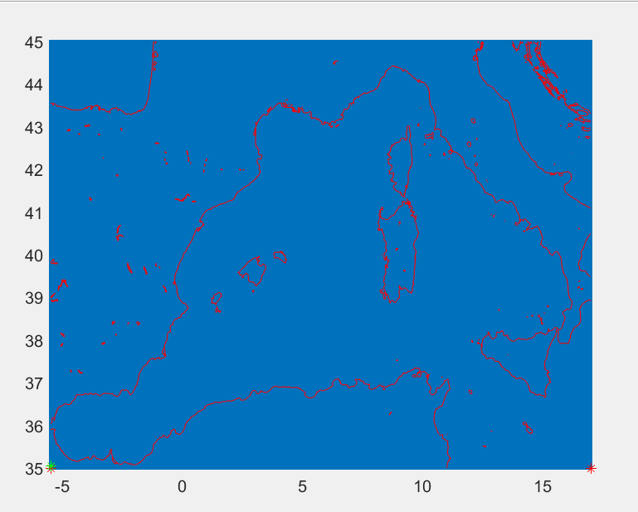
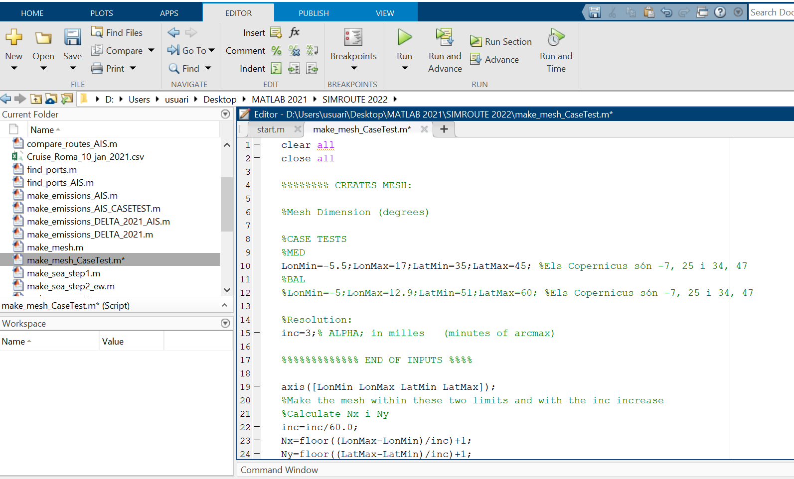
Copernicus is an EU programme aimed at developing European information services based on satellite Earth Observation and in situ (non space) data.
Copernicus is implemented by the European Commission (EC) with the support from the European Space Agency (ESA) for the Space component and the European Environment Agency (EEA) for the in situ component.
The objective of Copernicus is to monitor and forecast the state of the environment on land, sea and in the atmosphere, in order to support climate change mitigation and adaptation strategies, the efficient management of emergency situations and the improvement of the security of every citizen. Information provided by Copernicus improves people's safety, e.g. by providing information on natural disasters such as forest fires or floods, and thus help to prevent the loss of lives and property, and damages to the environment.
Copernicus is a user driven programme and the information services provided are available to its Users, mostly public authorities, on a full, open and free-of-charge basis.
make_mesh.m
Notes:
This script creates the Mediterranean Sea computational mesh defining the maximum and
minimum longitudes and latitudes. Furthermore, it can determine the computational mesh
resolution results by altering the quantity of nodes as desired.

Slide 5
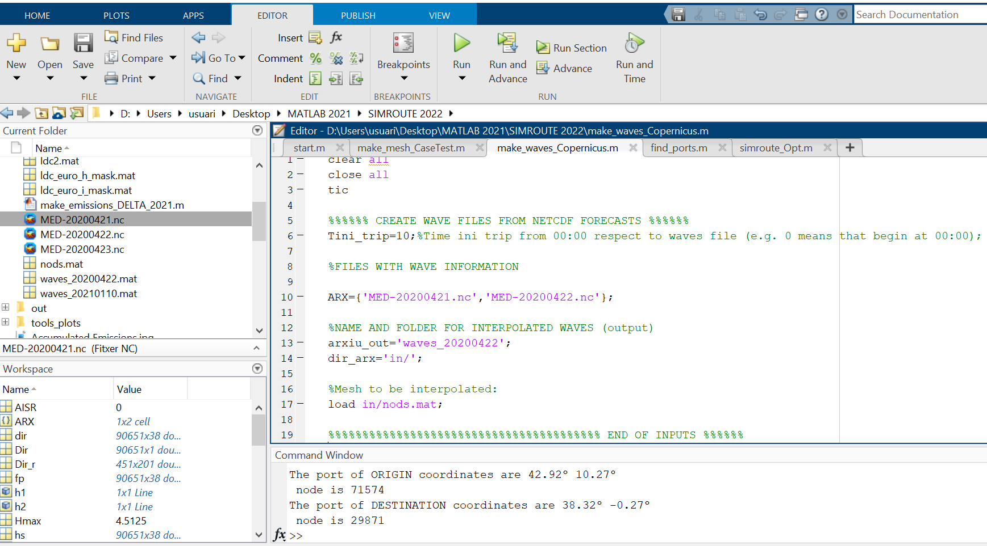
Copernicus is an EU programme aimed at developing European information services based on satellite Earth Observation and in situ (non space) data.
Copernicus is implemented by the European Commission (EC) with the support from the European Space Agency (ESA) for the Space component and the European Environment Agency (EEA) for the in situ component.
The objective of Copernicus is to monitor and forecast the state of the environment on land, sea and in the atmosphere, in order to support climate change mitigation and adaptation strategies, the efficient management of emergency situations and the improvement of the security of every citizen. Information provided by Copernicus improves people's safety, e.g. by providing information on natural disasters such as forest fires or floods, and thus help to prevent the loss of lives and property, and damages to the environment.
Copernicus is a user driven programme and the information services provided are available to its Users, mostly public authorities, on a full, open and free-of-charge basis.
make_waves_Copernicus.m
Notes:
This script uses the Copernicus data and the file created by make_mesh.m for creating a
.mat file with the waves and their direction which are interpolated at the created mesh.
Furthermore, it defines the vessel’s time of departure from the selected port of origin.
Therefore, it is necessary to define the initial time of the trip and the name of the file (or
files) downloaded from Copernicus.
Each file poses the waves conditions (wave height and direction) of one entire day (hourly
data). For instance, if the path of the route takes 80 hours and only 3 wave scripts
(accounting for 72 hours) have been introduced, the software will reply “error”. Once the
correct wave files are introduced and the estimated time of departure (ETD) is established,
an output wave script is obtained

Slide 6
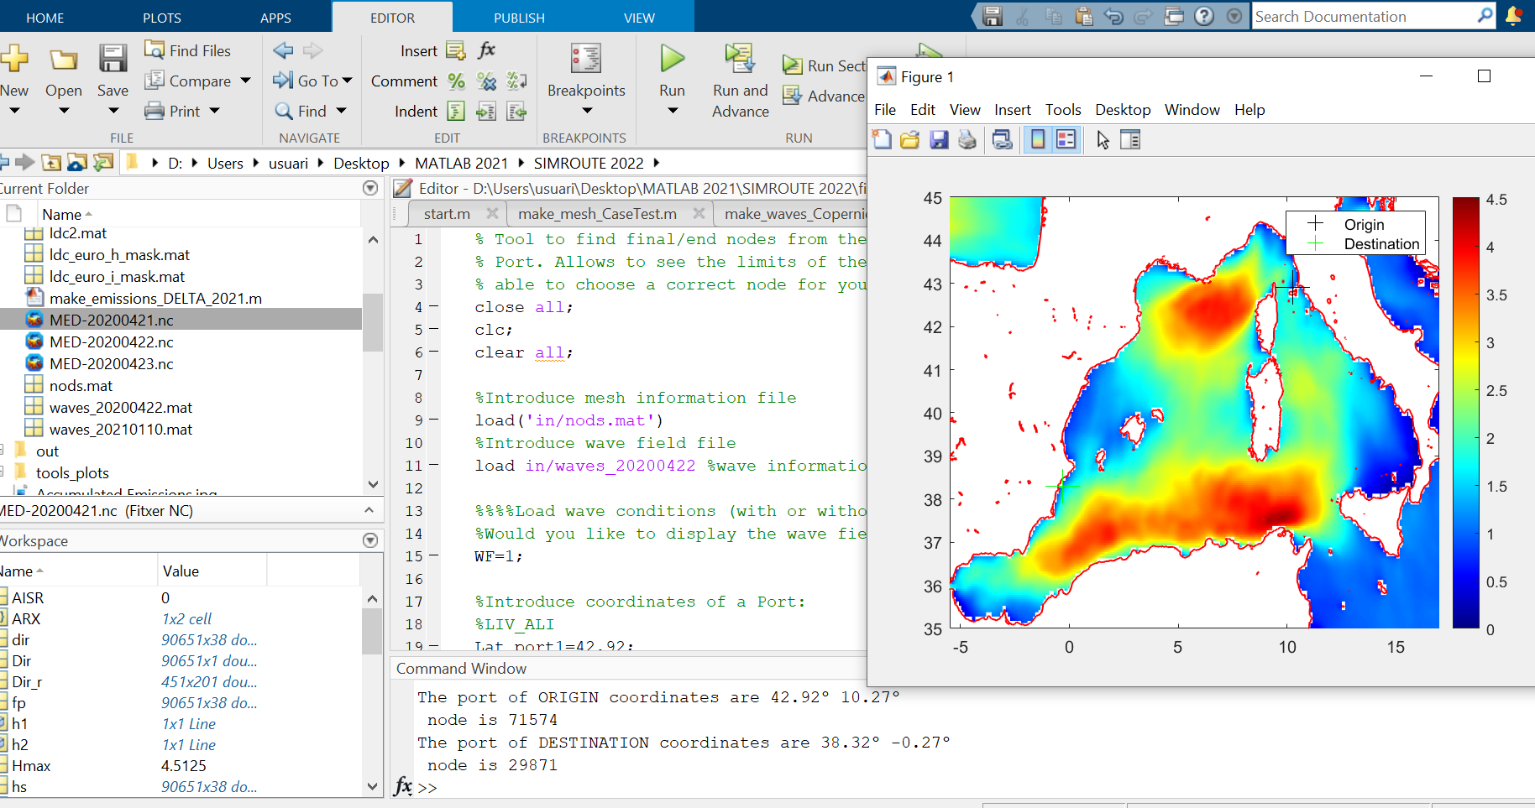
Copernicus is an EU programme aimed at developing European information services based on satellite Earth Observation and in situ (non space) data.
Copernicus is implemented by the European Commission (EC) with the support from the European Space Agency (ESA) for the Space component and the European Environment Agency (EEA) for the in situ component.
The objective of Copernicus is to monitor and forecast the state of the environment on land, sea and in the atmosphere, in order to support climate change mitigation and adaptation strategies, the efficient management of emergency situations and the improvement of the security of every citizen. Information provided by Copernicus improves people's safety, e.g. by providing information on natural disasters such as forest fires or floods, and thus help to prevent the loss of lives and property, and damages to the environment.
Copernicus is a user driven programme and the information services provided are available to its Users, mostly public authorities, on a full, open and free-of-charge basis.
find_ports.m
Notes:
the initial and end nodes (ports) may be easily determined. When the user introduces the latitude and
longitude of a point on the map, this function gives the node these coordinates represented on the mesh.
The function find_ports_New.m lets the user know whether the selected node is situated at land or at sea.

Slide 7
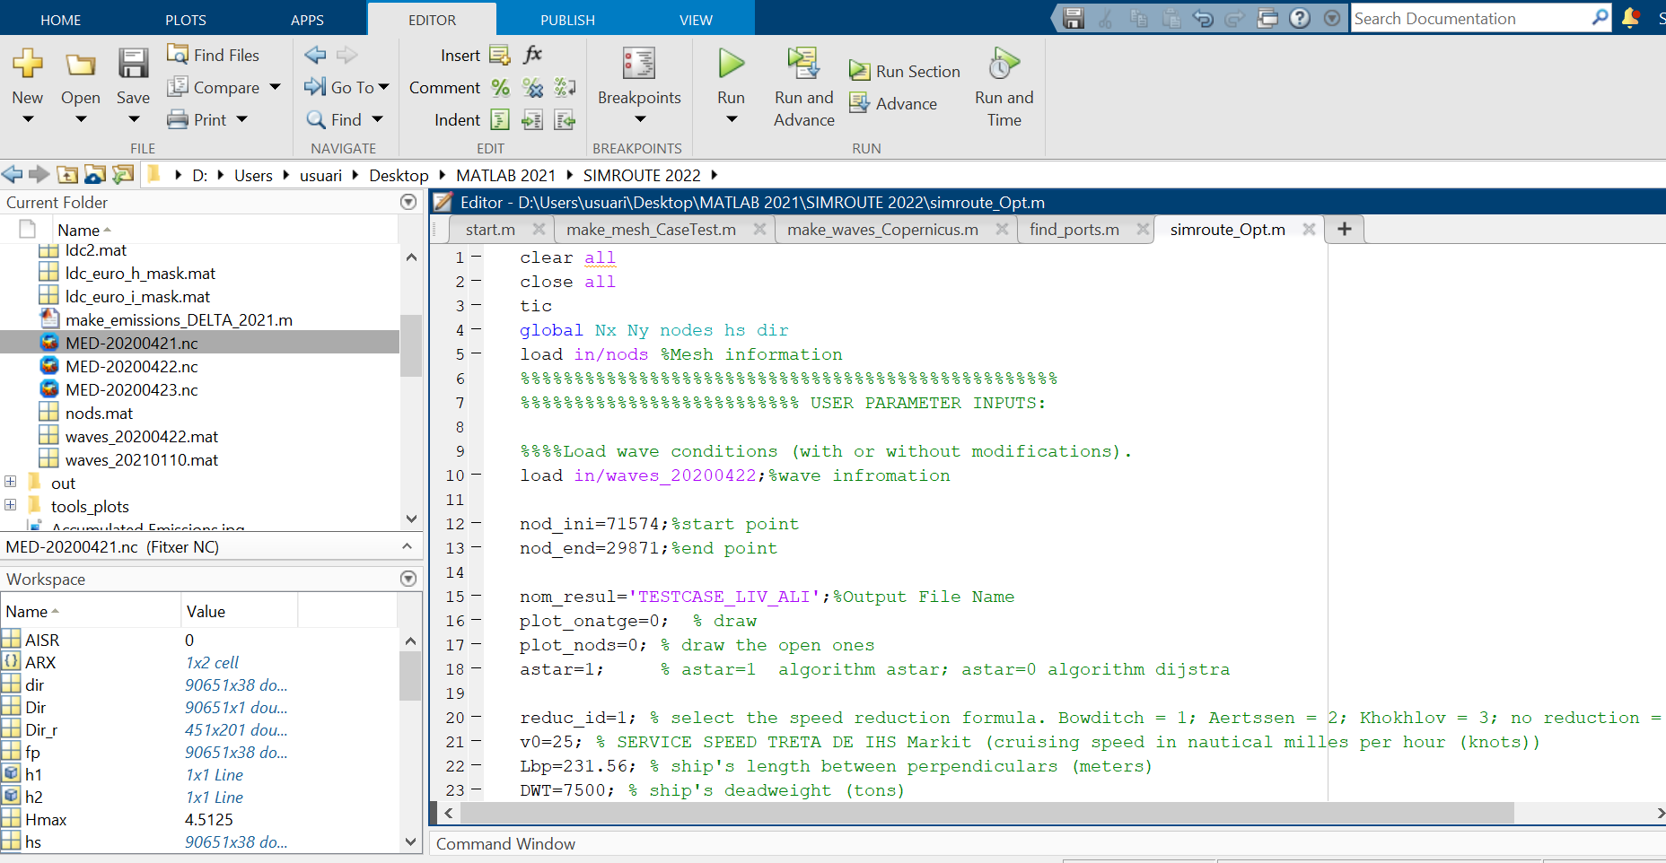
Copernicus is an EU programme aimed at developing European information services based on satellite Earth Observation and in situ (non space) data.
Copernicus is implemented by the European Commission (EC) with the support from the European Space Agency (ESA) for the Space component and the European Environment Agency (EEA) for the in situ component.
The objective of Copernicus is to monitor and forecast the state of the environment on land, sea and in the atmosphere, in order to support climate change mitigation and adaptation strategies, the efficient management of emergency situations and the improvement of the security of every citizen. Information provided by Copernicus improves people's safety, e.g. by providing information on natural disasters such as forest fires or floods, and thus help to prevent the loss of lives and property, and damages to the environment.
Copernicus is a user driven programme and the information services provided are available to its Users, mostly public authorities, on a full, open and free-of-charge basis.
Simroute_Opt.m
Notes:
This main script calculates the optimum route taking into account the wave information interpolated from start and end nodes.
When simroute_Opt.m is executed the initial speed of the vessel (v0) is modified taking into account the wave field.
The required inputs for simroute_Opt.m are:
- Start node
- End node
- Name of the file generated by make_waves.m
- Vessels cruising speed
Define whether Dijkstra o A* algorithm is going to be used. (A* is selected bydefault)
Select the speed reduction formula

Slide 8
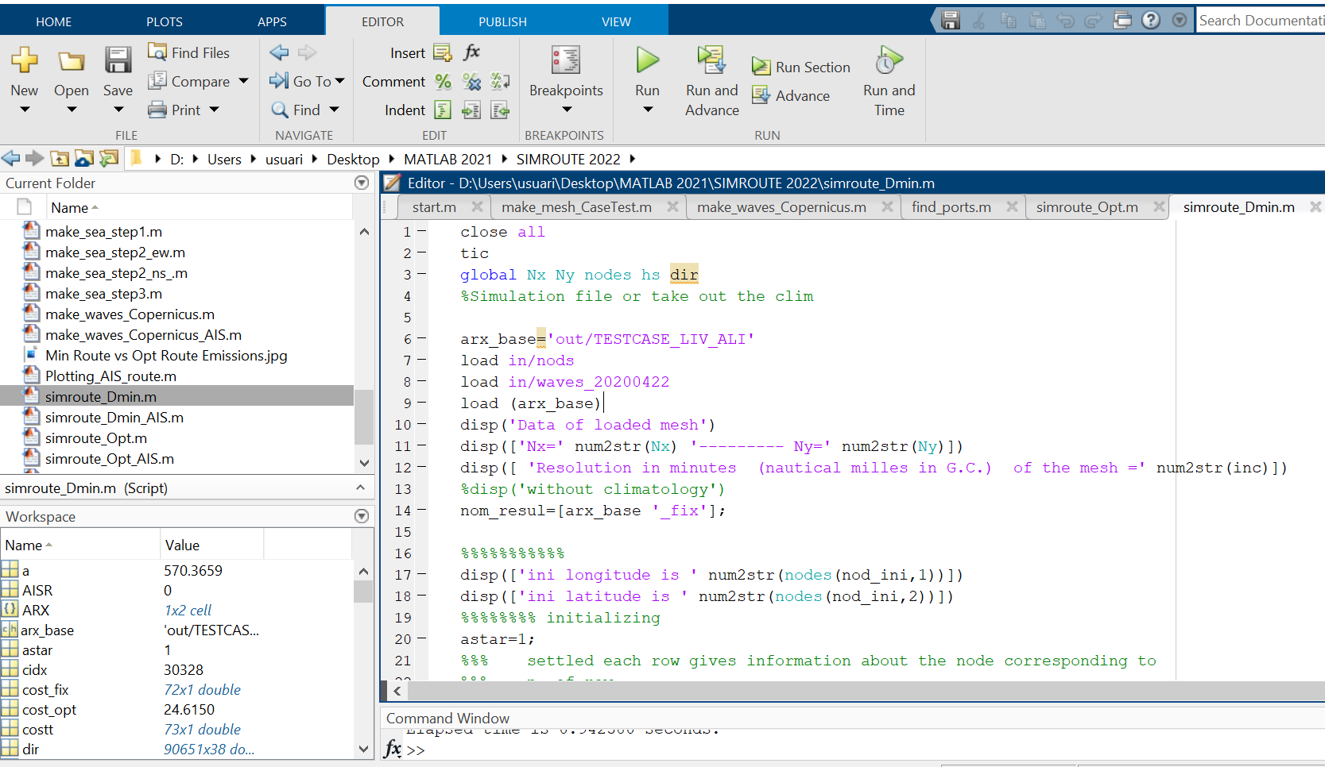
Copernicus is an EU programme aimed at developing European information services based on satellite Earth Observation and in situ (non space) data.
Copernicus is implemented by the European Commission (EC) with the support from the European Space Agency (ESA) for the Space component and the European Environment Agency (EEA) for the in situ component.
The objective of Copernicus is to monitor and forecast the state of the environment on land, sea and in the atmosphere, in order to support climate change mitigation and adaptation strategies, the efficient management of emergency situations and the improvement of the security of every citizen. Information provided by Copernicus improves people's safety, e.g. by providing information on natural disasters such as forest fires or floods, and thus help to prevent the loss of lives and property, and damages to the environment.
Copernicus is a user driven programme and the information services provided are available to its Users, mostly public authorities, on a full, open and free-of-charge basis.
Simroute_Dmin.m
Notes:
Taking the files generated by simroute_Opt.m and make_waves.m, this script carries out the calculations for the minimum distance route to be compared with the optimized route.
Through the output scripts that simroute_Opt.m creates, simroute_Dmin.m can be run and the results of the shortest path route, in hours, will be obtained.

Slide 9
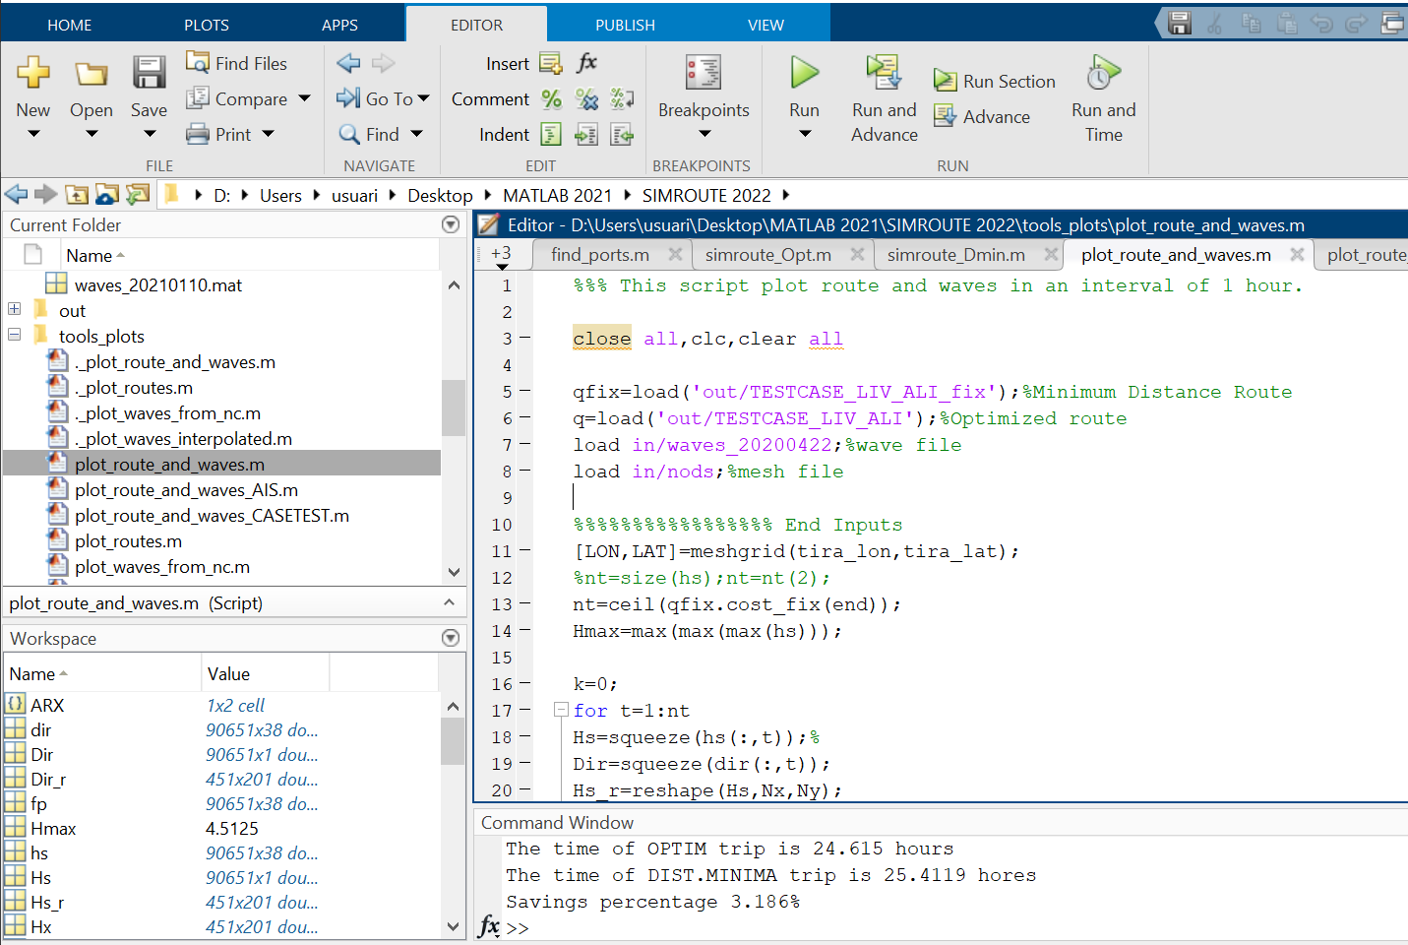
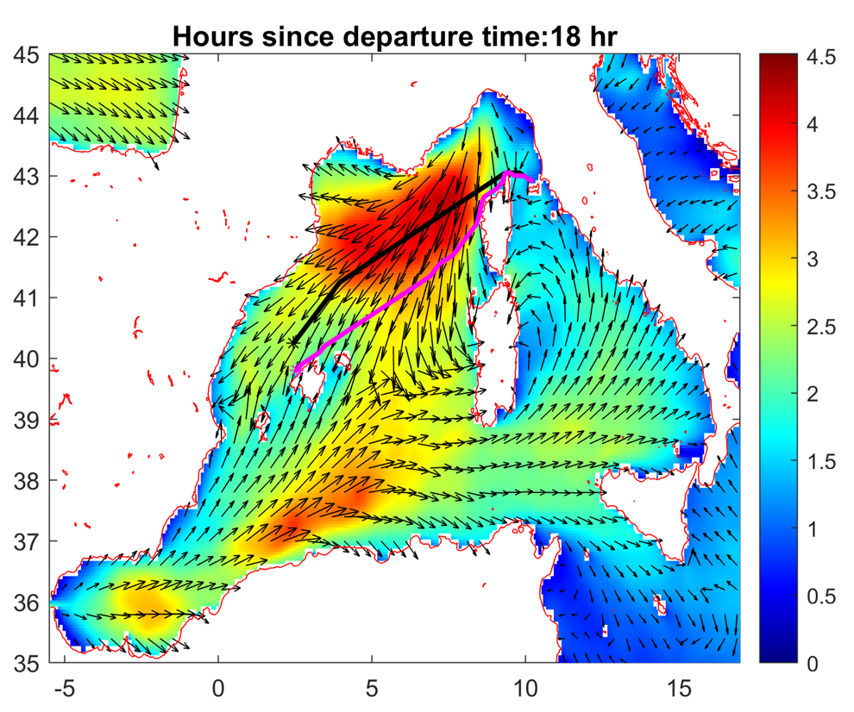
Copernicus is an EU programme aimed at developing European information services based on satellite Earth Observation and in situ (non space) data.
Copernicus is implemented by the European Commission (EC) with the support from the European Space Agency (ESA) for the Space component and the European Environment Agency (EEA) for the in situ component.
The objective of Copernicus is to monitor and forecast the state of the environment on land, sea and in the atmosphere, in order to support climate change mitigation and adaptation strategies, the efficient management of emergency situations and the improvement of the security of every citizen. Information provided by Copernicus improves people's safety, e.g. by providing information on natural disasters such as forest fires or floods, and thus help to prevent the loss of lives and property, and damages to the environment.
Copernicus is a user driven programme and the information services provided are available to its Users, mostly public authorities, on a full, open and free-of-charge basis.
Plot_route_and_waves.m
Notes:
This script is run order to see the evolution of the storm and the optimized and the minimum distance route in an hourly manner

Slide 10
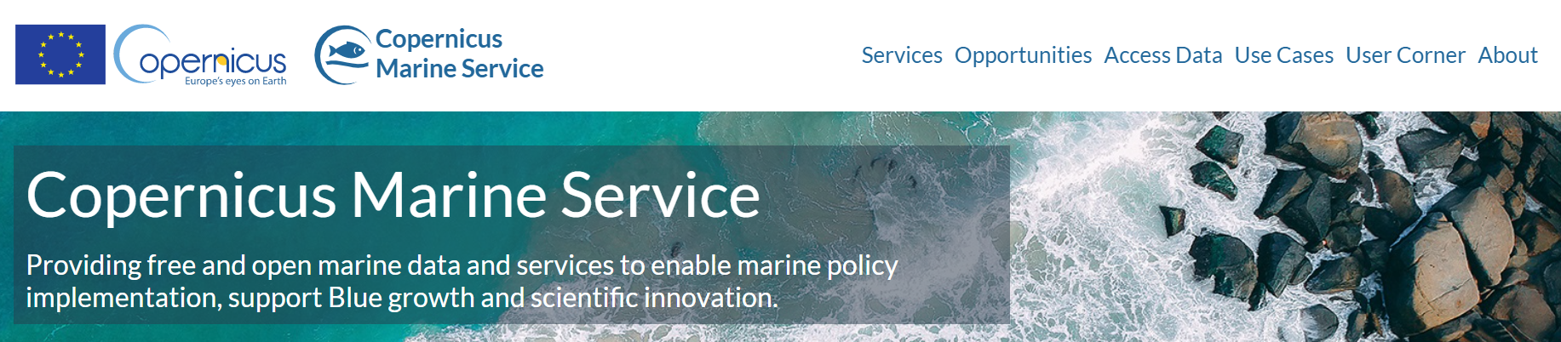
WHAT IS COPERNICUS?
“Copernicus is an EU program aimed at developing European information services based on satellite Earth Observation and in situ (non space) data.”
Objective: to monitor and forecast the state of the environment on land, sea and in the atmosphere, in order to support climate change mitigation and adaptation strategies, among others.
Notes:
Copernicus is a user driven program and the information services provided are available on a full, open and free-of-charge basis.

Slide 11
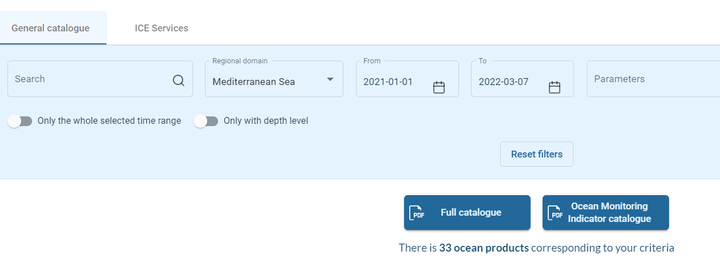
HOW TO DOWNLOAD COPERNICUS FILES?
https://marine.copernicus.eu/
On Copernicus web page, go to Ocean Products
Register/sign
Select regional domain

Slide 12
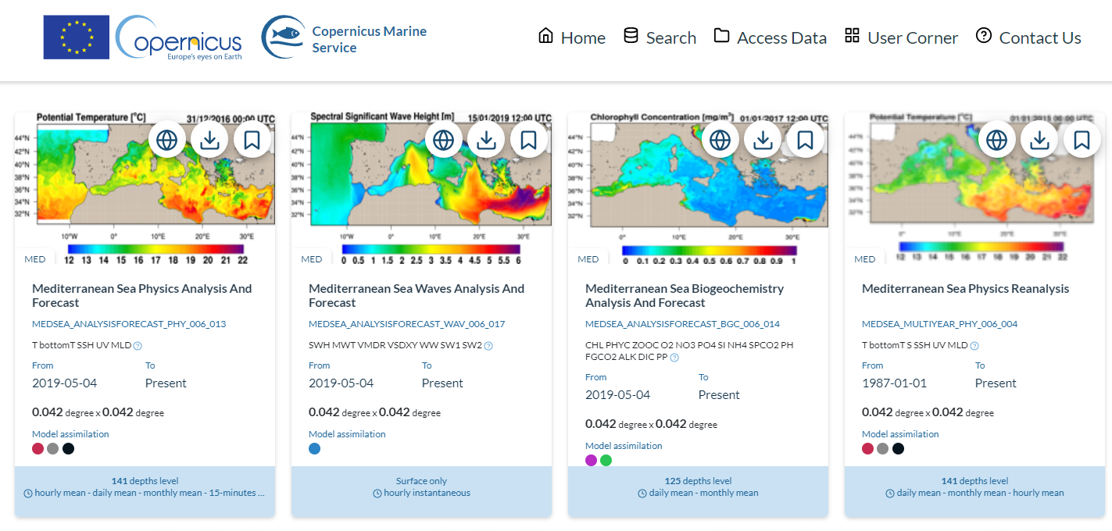
HOW TO DOWNLOAD COPERNICUS FILES?
Select product

Slide 13
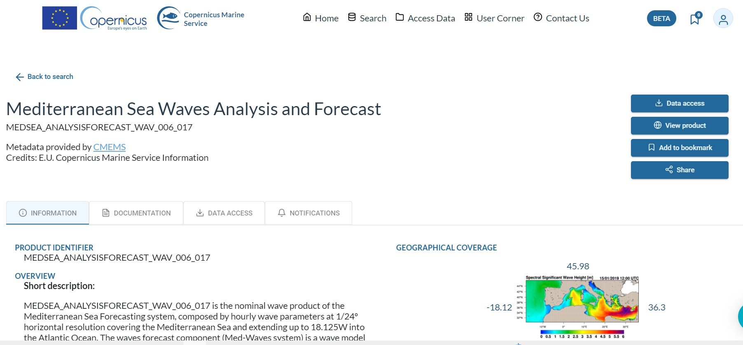
and free-of-charge basis.
HOW TO DOWNLOAD COPERNICUS FILES?

Slide 14
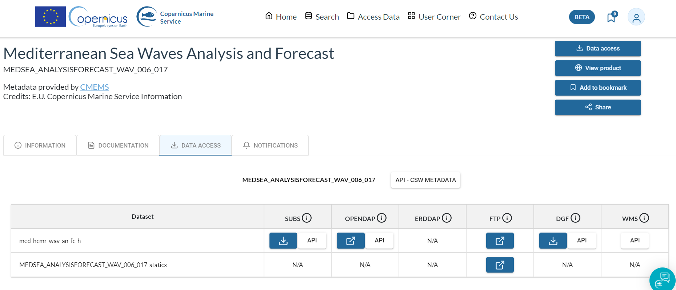
Copernicus is an EU
HOW TO DOWNLOAD COPERNICUS?

Slide 15
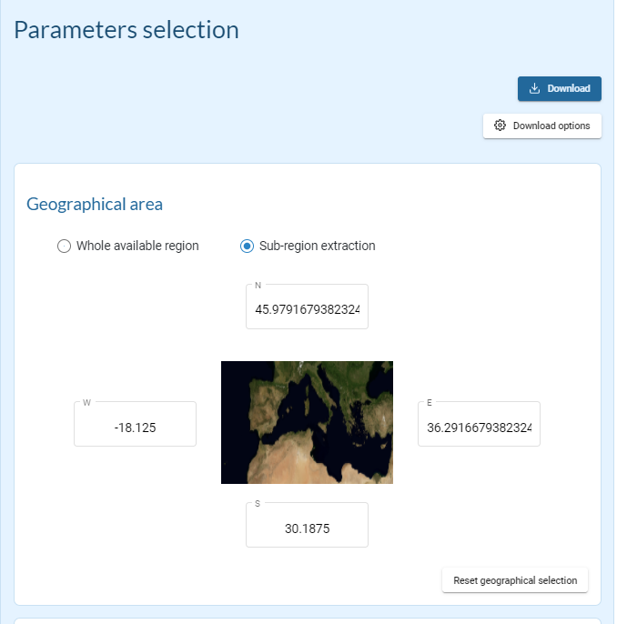
Copernicus is an EU
HOW TO DOWNLOAD COPERNICUS?
5) Select wave file limits by choosing minimum and maximum longitudes and latitudes (zone to investigate must fit inside the limits)

Slide 16
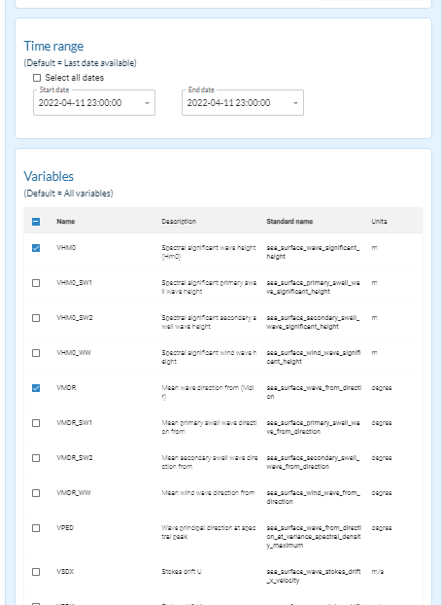
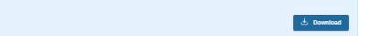
Copernicus is an EU
HOW TO DOWNLOAD COPERNICUS?
6) Select time range and variables:
VHMO: Sea surface wave
significant height (m)
VMDR: Sea surface wave
from direction (degrees)
VTM01_SW1: Sea surface
primary swell wave
mean period
7) Download data and save in IN folder

